Slide 1

APBD – lecture 10
Web applications
ASP.NET MVC

Slide 2
Desktop vs Web application etc.
During our classes we are talking mostly about web apps.
WebApps nowadays have a lot of advantages over classical desktop apps related mostly to advancements in web technologies and web browsers.

Slide 3
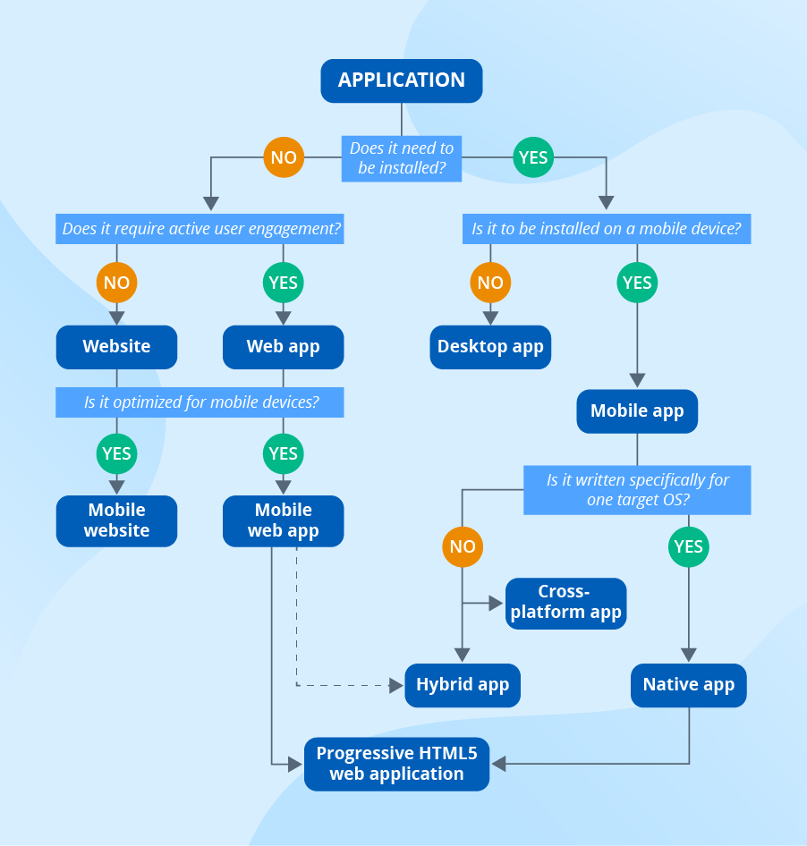
How to choose what kind of app we want to use?
https://www.scnsoft.com/blog/mobile-web-app-types

Slide 4
Web technologies
Web browsers - Browsers request information and then they show us in the way we can understand. Think of them as the interpreters of the web. (Google Chrome, Safari, Firefox, Edge etc.)

Slide 5
Web technologies
HTML5 - HTML is a markup language which is used by the browser to manipulate text, images and other content to display it in required format.
Nowadays HTML5 is a living standard.
HTML5 constists not only from the definitione of „tags”. There are also numerous APIs
HTML Standard (whatwg.org)
https://www.w3.org/TR/html52/

Slide 6
Web technologies
CSS3
Used for styling the HTML elements
Cascading Style Sheets Level 3 (CSS3) is the iteration of the CSS standard used in the styling and formatting of Web pages.
CSS3 incorporates the CSS2 standard with some changes and improvements.
https://www.w3.org/TR/2001/WD-css3-roadmap-20010523/

Slide 7
Web technologies
JavaScript (EcmaScript)
Is a general-purpose programming language, standardised by Ecma International according to the document ECMA-262
https://www.ecma-international.org/publications-and-standards/standards/ecma-262/
JavaScript is an interpreted language, not a compiled language.
At the beginning used only for simple web site scripting – nowadays we can say that its a multi-purpose language used for web, server, mobile etc.
Big change for development of JS language was introduction of Node.js (around 2010-2011)
https://www.youtube.com/watch?v=jo_B4LTHi3I

Slide 8
Website, webapps etc.
We will try to get step-by-step a numer of different ways to create a website/webapp

Slide 9
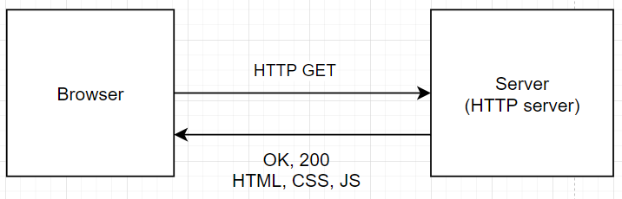
1. Static website (HTML, CSS, JS)

Slide 10
EXAMPLE

Slide 11
2. MPA – server-side rendered app
We would like the content of the website to be dynamic (for ex. different for every user).
We can use different server-side rendering for that (SSR)
There are a lot of server-side technologies we can use for that:
Java, C#, Python, JS (Node.js), Ruby, etc.
What are the advantages and disadvantages of MPA?

Slide 12
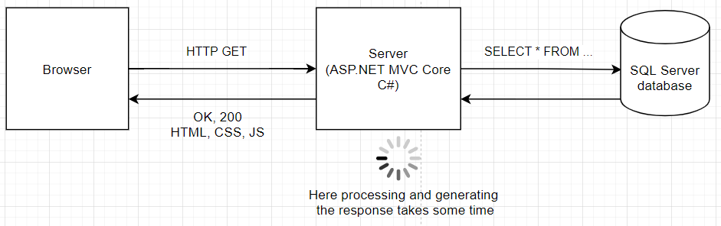
2. MPA – server-side rendered app

Slide 13
EXAMPLE

Slide 14
3. SPA – Single-page applications
A single-page application is an app that works inside a browser and does not require page reloading during use. You are using this type of applications every day. These are, for instance: Gmail, Google Maps, Facebook or GitHub.
SPAs are all about serving an outstanding UX by trying to imitate a “natural” environment in the browser — no page reloads, no extra wait time.

Slide 15
3. SPA – Single-page applications
SPA requests the markup and data independently and renders pages straight in the browser.
We can do this thanks to the advanced JavaScript frameworks like AngularJS, Ember.js, Meteor.js, Knockout.js, React.js, Vue.js
Another important step in developing SPA was introducing possibility of making AJAX requests directly from the browser
What are the advantages and disadvantages of SPA?

Slide 16
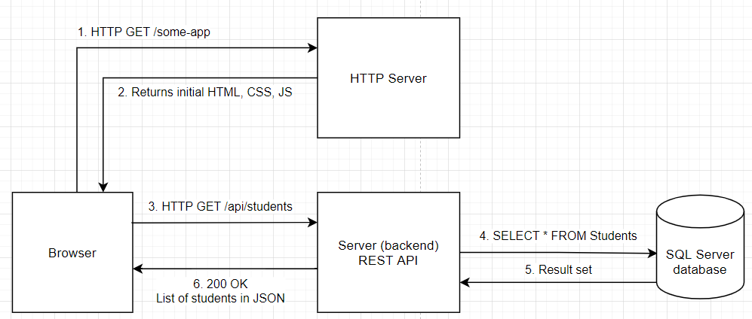
3. SPA – Single-page applications

Slide 17
4. PWA – Progressive Web Apps, Hybrid web apps
Progressive Web Apps are using extensively modern HTML5 apis – especially those related to caching the data on the client side. This way we are able to create a web application that can work offline.
Hybrid apps – mixing the SPA approach with SSR. Often using technologies like Next.js or Gatsby.js
What are the advantages and disadvantages of PWA/Hybrid apps?

Slide 18
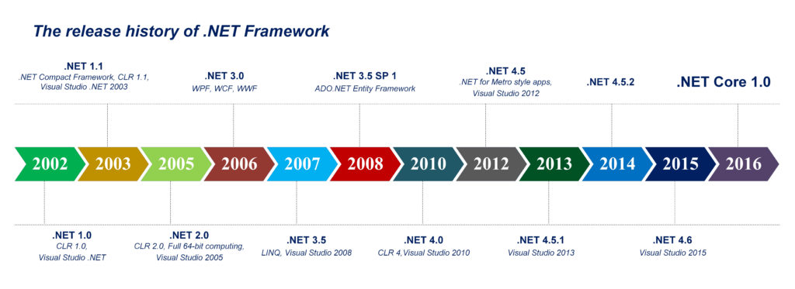
.Release history

Slide 19
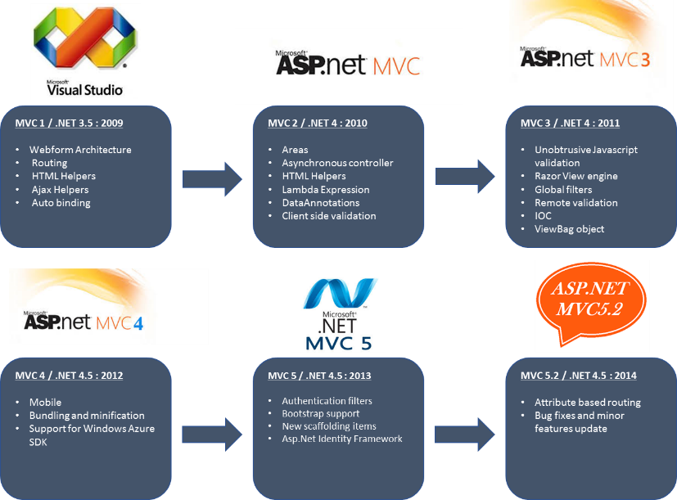
ASP.NET MVC history

Slide 20
ASP.NET MVC Core
ASP.NET Core MVC is a rich framework for building web apps and APIs using the Model-View-Controller design pattern.
What is the MVC pattern?
The Model-View-Controller (MVC) architectural pattern separates an application into three main groups of components: Models, Views, and Controllers. This pattern helps to achieve separation of concerns.

Slide 21
Model Responsibilities
The Model in an MVC application represents the state of the application and any business logic or operations that should be performed by it. Business logic should be encapsulated in the model, along with any implementation logic for persisting the state of the application.

Slide 22
View Responsibilities
Views are responsible for presenting content through the user interface. They use the Razor view engine to embed .NET code in HTML markup.

Slide 23
Controller Responsibilities
Controllers are the components that handle user interaction, work with the model, and ultimately select a view to render.
In an MVC application, the view only displays information; the controller handles and responds to user input and interaction. In the MVC pattern, the controller is the initial entry point, and is responsible for selecting which model types to work with and which view to render (hence its name - it controls how the app responds to a given request).

Slide 24
What is ASP.NET Core MVC
The ASP.NET Core MVC framework is a lightweight, open source, highly testable presentation framework optimized for use with ASP.NET Core.
ASP.NET Core MVC provides a patterns-based way to build dynamic websites that enables a clean separation of concerns. It gives you full control over markup, supports TDD-friendly development and uses the latest web standards.

Slide 25
Example

Slide 26
Routing
ASP.NET Core MVC is built on top of ASP.NET Core's routing, a powerful URL-mapping component that lets you build applications that have comprehensible and searchable URLs. Convention-based routing enables you to globally define the URL formats that your application accepts and how each of those formats maps to a specific action method on a given controller

Slide 27
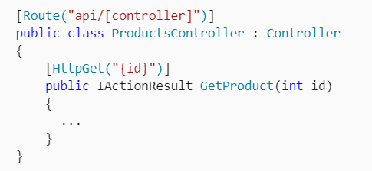
Routing
Attribute routing enables you to specify routing information by decorating your controllers and actions with attributes that define your application's routes.

Slide 28
Model binding
ASP.NET Core MVC model binding converts client request data (form values, route data, query string parameters, HTTP headers) into objects that the controller can handle.
As a result, your controller logic doesn't have to do the work of figuring out the incoming request data; it simply has the data as parameters to its action methods.

Slide 29
Model validation
ASP.NET Core MVC supports validation by decorating your model object with data annotation validation attributes. The validation attributes are checked on the client side before values are posted to the server, as well as on the server before the controller action is called.

Slide 30
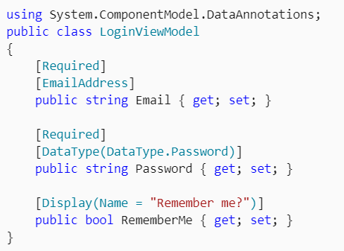
Model validation

Slide 31
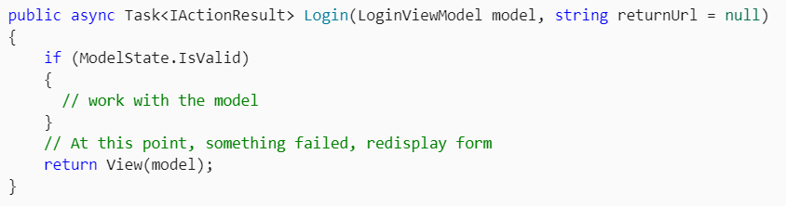
Model validation

Slide 32
Dependency injection
ASP.NET Core has built-in support for dependency injection (DI). In ASP.NET Core MVC, controllers can request needed services through their constructors, allowing them to follow the Explicit Dependencies Principle.

Slide 33
Filters
Filters help developers encapsulate cross-cutting concerns, like exception handling or authorization.
Filters enable running custom pre- and post-processing logic for action methods, and can be configured to run at certain points within the execution pipeline for a given request. Filters can be applied to controllers or actions as attributes (or can be run globally).

Slide 34
Razor view engine
ASP.NET Core MVC views use the Razor view engine to render views. Razor is a compact, expressive and fluid template markup language for defining views using embedded C# code.
Razor is used to dynamically generate web content on the server. You can cleanly mix server code with client side content and code.

Slide 35
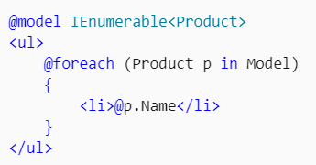
Strongly typed views
Razor views in MVC can be strongly typed based on your model.
Controllers can pass a strongly typed model to views enabling your views to have type checking and IntelliSense support.

Slide 36
Bibliography
Overview of ASP.NET Core MVC | Microsoft Docs
Get started with ASP.NET Core MVC | Microsoft Docs
https://docs.microsoft.com/en-us/aspnet/core/mvc/overview?view=aspnetcore-5.0
https://www.c-sharpcorner.com/article/getting-started-with-net-core-on-visual-studio-2017/

